Slide 1

TETRA
Data and SCADA Applications
Funk-Electronic Piciorgros GmbH Stephanie D. Piciorgros

Slide 2
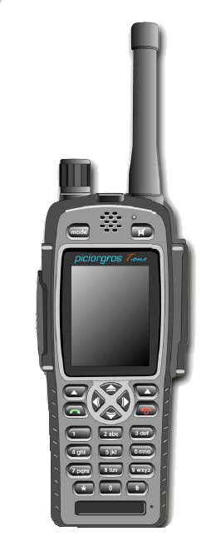
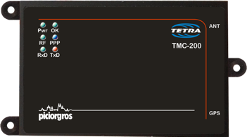
Funk-Electronic Piciorgros GmbH
(TMC-200 / T-One Terminal)
350, 380, 410, 450, 800 MHz
Status, SDS, Packet Data, MSPD
Authentication, Encryption,
TEA1, 2, 3

Slide 3
Why TETRA for SCADA Applications?
Supervise Control And Data Acquisition in privately owned network
Controlled locally or in remote locations
Small to medium size data packets, perfect for narrowband
TETRA communication methods ideal for SCADA:
Status Message
SDS Message
Packet Data

Slide 4
TMO-100 = Tetra MOdem -100
Second Generation
Professional TETRA
Data Modem with Voice Option

Slide 5
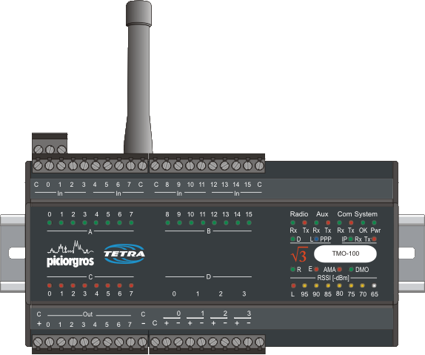
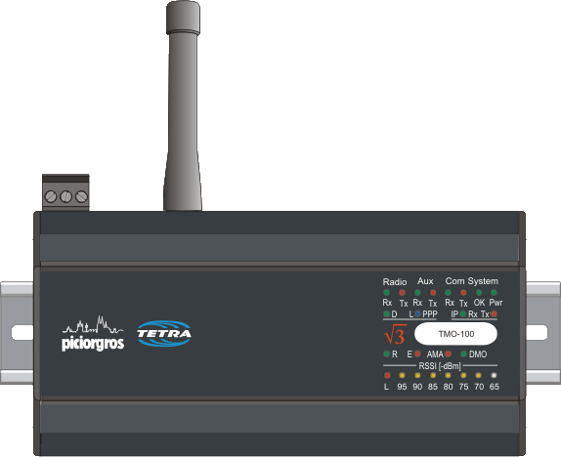
TETRA Modem and RTU for SCADA applications with and without embedded I/Os

Slide 6
TMO-100 - TETRA related Features
SDS can be up to 255 bytes (2047 Bit) long. Type TL and TL 4
Packet Switched Data (IP) supported
Packet Data Channel Sharing supported
Single and Multi Slot Packet Data supported
Secondary Control Channel supported
Automatic PPP Link set up to the TETRA Switch
Router Function with Port Forwarding and NAT
Up to 3 Watt RF Output Power
Encryption, Authentication
Voice feature even with active Packet Data Link
Build in Tetra Monitor (local and remote) via embedded Web Server
Calibrated Field Strength Indicator on the Front Panel
Short Data or SDS can be sent as alarms (low field strength ...)
350 MHz, 380 MHz, 410 MHz 450 MHz and 800 MHz available

Slide 7
TMO-100
Feature rich All in One SCADA and Telemetry Solution
TETRA-Modem and TETRA-RTU
Interfaces fit the User Requirements and User Protocols (no ATDT .... Commands)
Embedded WEB Server
Embedded IP Router
Optional build in Digital and Analog I/O
Optional Voice Feature
Field proven in many applications
IOP approved for most of the existing infrastructures
IC and FCC approval
3 Watt RF power output in 350 – 470 MHz range
DIN Rail Mounting and 12-24 Volt DC +/-20% power supply
Over The Air Upgrade of Modem and TETRA Stack

Slide 8
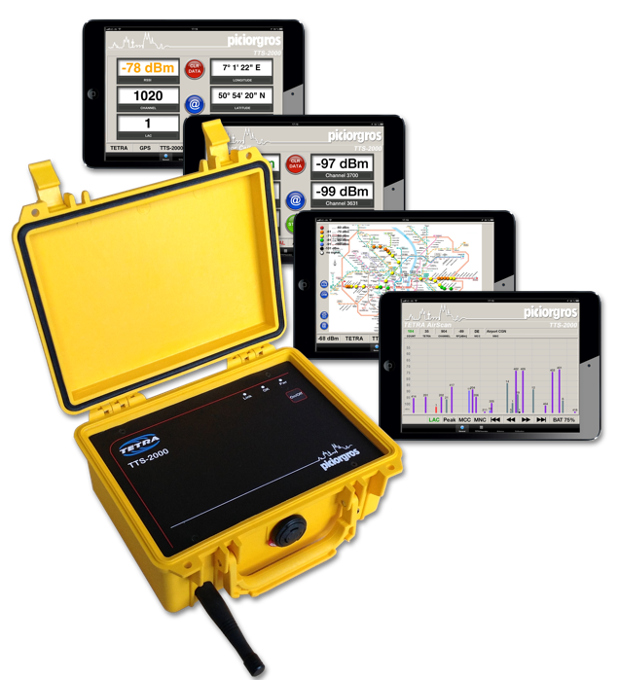
TTS-2000 - TETRA Site Survey Test Set and Analysis Tool

Slide 9
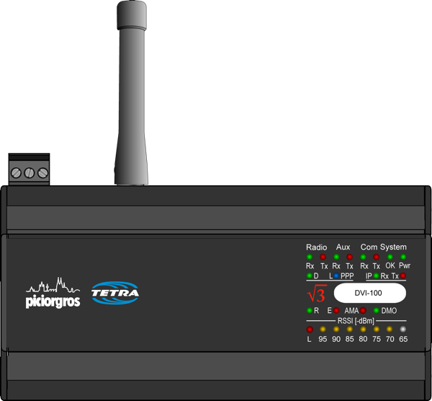
DVI-100 - TETRA Voice Bridge to interconnect different TETRA Infrastructures via air interface

Slide 10
TMO-100 TETRA Data Modem and RTU Case Studies

Slide 11

Airport Case Studies

Slide 12





Airport Applications
Gate Allocation
Flight info display system
Baggage handling
AC/Heat control
Lighting control
Gate or Door control
Thermal cameras on runway (Detect wildlife or intruders)
Pre-configured messages for voice alarms
Measuring wind speeds around runways
Supervision of elevators and escalators

Slide 13
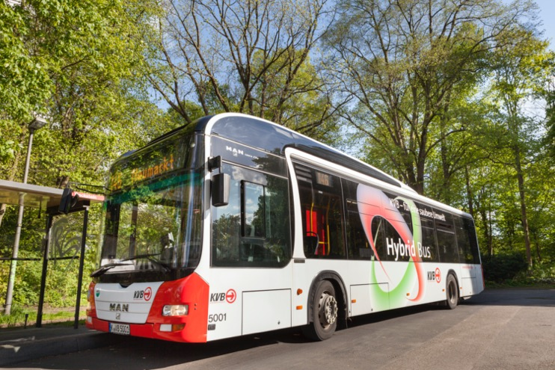
Public Transportation Case Studies

Slide 14




Public Transportation Applications
Supervision of elevators and escalators
Entry control for doors/gates
Managing public transportation arrival time displays
Monitoring fuel tank levels in depots
Observing functionality of vehicles
Pre-Configured voice messages fed to speakers
AC/ heater control and control of ventilation system underground
Managing pumps in tunnels
Controlling of track switches and heaters during winter
Sending location of vehicles to Control Room

Slide 15
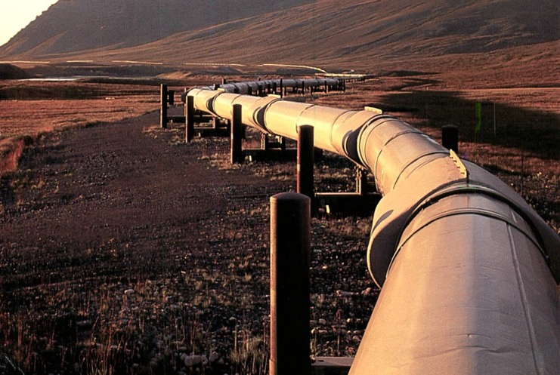
Oil and Gas Case Studies

Slide 16
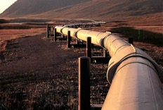



Oil and Gas Applications
Leak detection in pipe line
Detection of Spills (send alarm)
Gas and Flame Detection
Measuring temperature of oil/gas in pipe line
Controlling pressure of well heads
Observation of flow rate in pine line
Controlling of valves and Chokes
Cathodic Corrosion Protection
Siren or pre-configured voice Alarming in case of emergency in plant

Slide 17
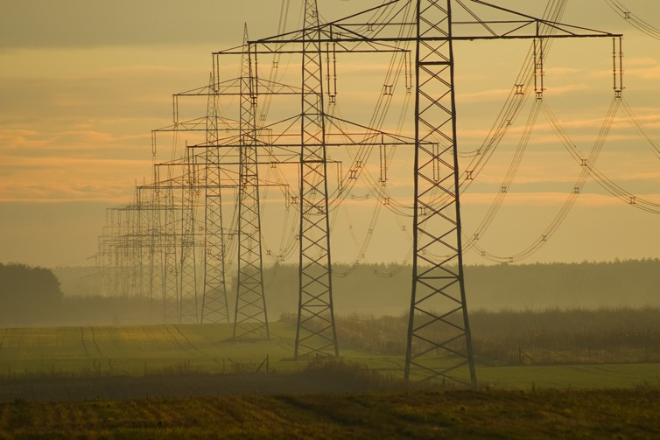
Electricity Case Studies

Slide 18




Electricity Applications
Smart Meter Reading
Street Light Control
Monitoring transformer sub-stations
Controlling Circuit breakers
Pole mounted switches
Smart grid – turning on and off sections of transmission line
Controlling and monitoring of renewable energy supplies (photovoltaic/ wind turbines)
Controlling of warning lights for transmission towers in airport proximity
Monitor on- and off-shore wind generators
Intrusion alarm for sub-stations

Slide 19
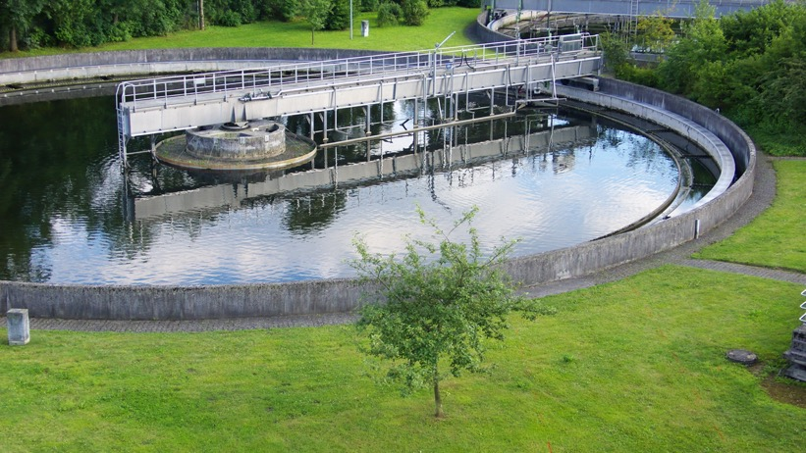
Water and Waste Water Case Studies

Slide 20




Water and Waste Water Applications
Measuring sensors in water tanks
Turning on and off water pumps
Measuring purity and cleanliness of fresh water
Opening/ Closing valves in case of emergency
Emergency shut down in case impurities are found in fresh water
Pump engine overheat protection
Temperature, pressure, flow of water (e.g. pulse counter inputs) in pipe lines
Leak detection of water pipe lines
Monitoring of water level of rivers, dams and canals
Tsunami/Hurricane warning system

Slide 21
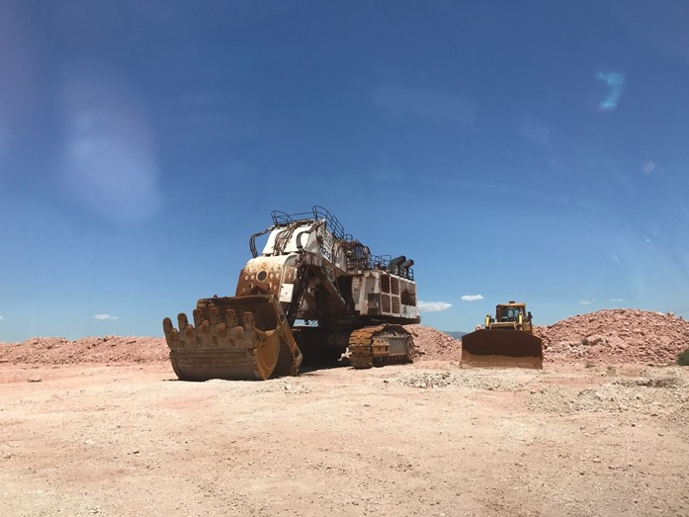
Mining Case Studies

Slide 22




Mining Applications
Floor warning system in case of heavy rain
Managing pumps for dewatering
Groundwater well monitoring
Monitor the heavy machinery by checking operation and maintenance data
Monitoring vehicle location (GPS)
Collision prevention
Controlled remote blasting
Collection of seismic data before blasting
Alarming system in case of emergency (pre-configured voice messages fed to speakers)
Back up for terminals underground (speak to control room in case of emergency)

Slide 23
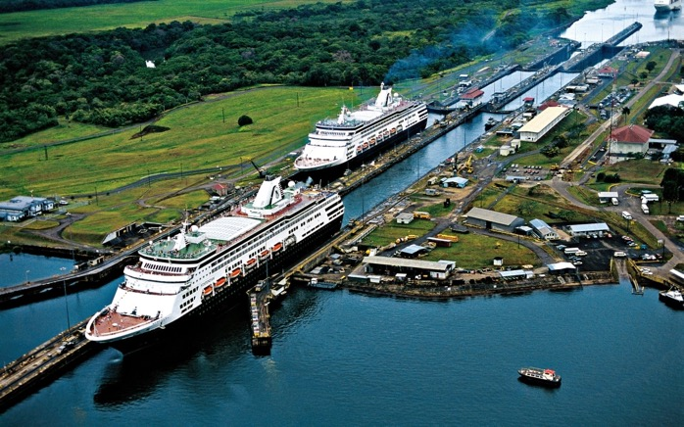
Special Case Study – The Panama Canal

Slide 24


Special Case Application – the Panama Canal
Floor warning system
Managing pumps
Opening/ Closing of gates/ water gates
Buoy Monitoring (weather monitoring)
Alarming system in case of emergency (pre-configured voice messages fed to speakers)

Slide 25

For the next (at least) 10-20 years

Slide 26

Thank you very much for your interest in our Products
Funk - Electronic Piciorgros GmbH
Claudiastr. 5
51145 Köln-Porz
Germany
www.TetraModem.com

