Slide 1

TETRA-RTU and TETRA-Modem
TMO-100
Funk-Electronic Piciorgros GmbH
Michael D. Piciorgros (CEO)

Slide 2
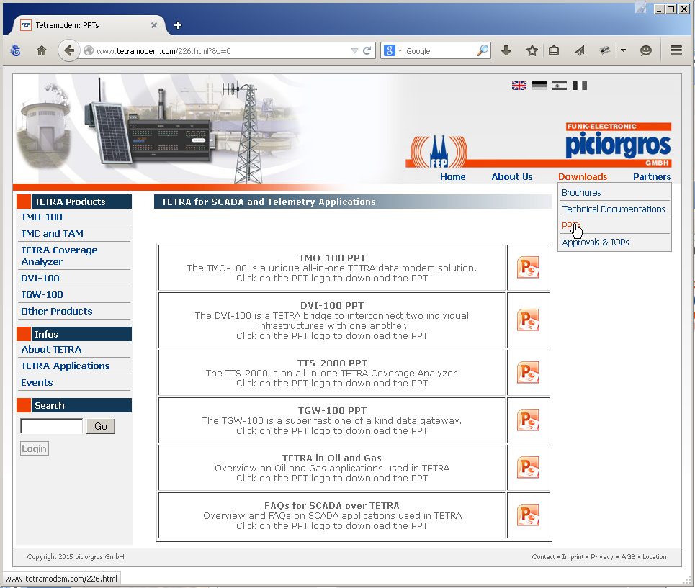
Information Source
www.TetraModem.com

Slide 3
Funk-Electronic Piciorgros GmbH
(TETRA Business)
Wireless Solutions from 1982 until 2023++
Member of the TETRA Association (MoU/TandCCA)
Core Manufacturer (Own TETRA Terminal)
IOP certified from ISCOM (Italy)
Member of the SME Group

Slide 4
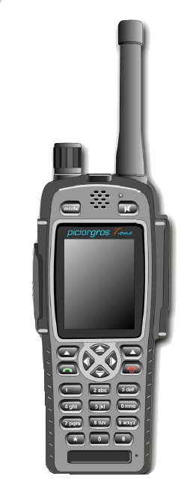
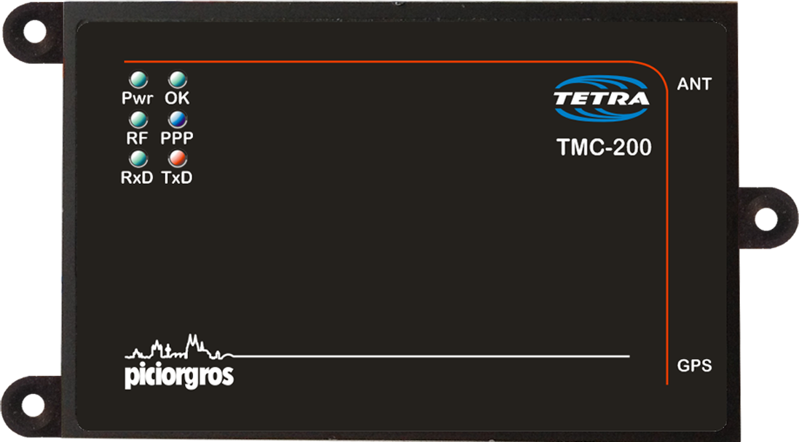
Funk-Electronic Piciorgros GmbH
(TMC-200 / T-One Terminal)
350, 380, 410, 450, 800 MHz
Status, SDS, Packet Data, MSPD
Authentication, Encryption,
TEA1, 2, 3

Slide 5



Funk-Electronic Piciorgros GmbH
(National Approvals)
EU (BABT Certificate)
Hong Kong, Thailand, Russia
FCC (USA), IC (Canada)
Philippines, Australia, Malaysia

Slide 7
Funk-Electronic Piciorgros GmbH
(IOP Certificates)
Rohill
SELEX
EADS / Cassidian
3T-Frequentis (Sepura)
Damm, Motorola
Teltronics
Hytera, (ETELM)

Slide 8
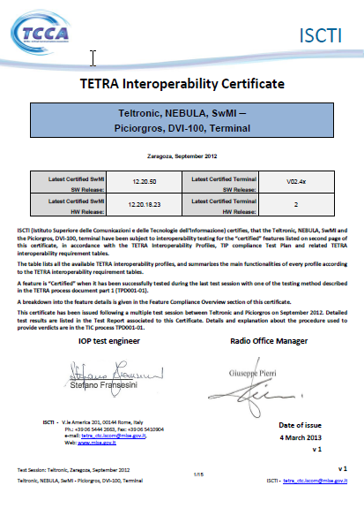
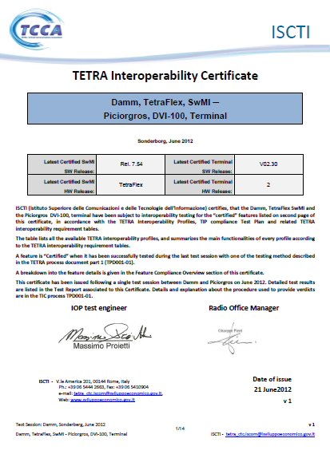
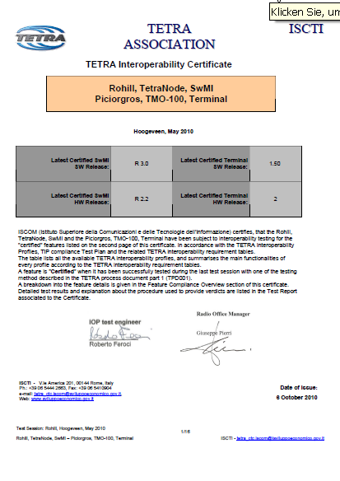
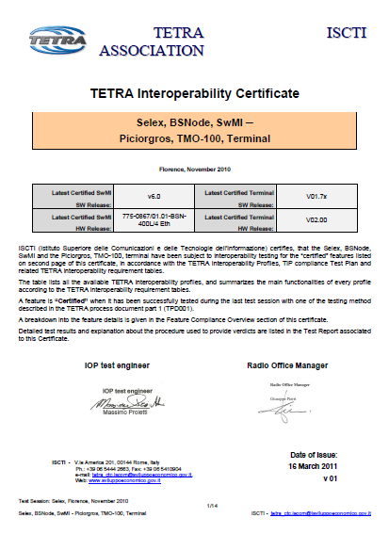



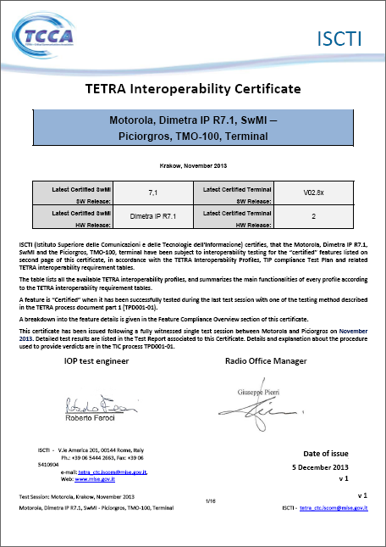
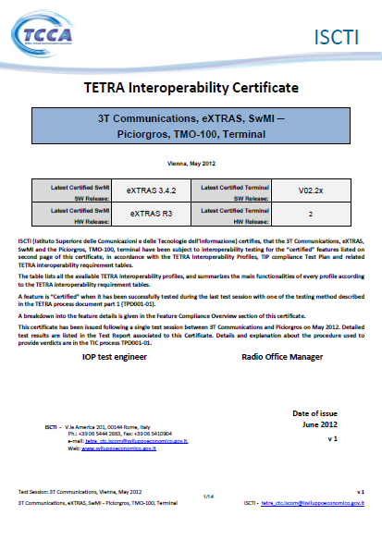
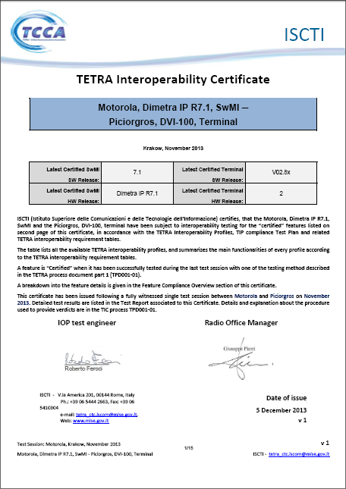

Slide 9
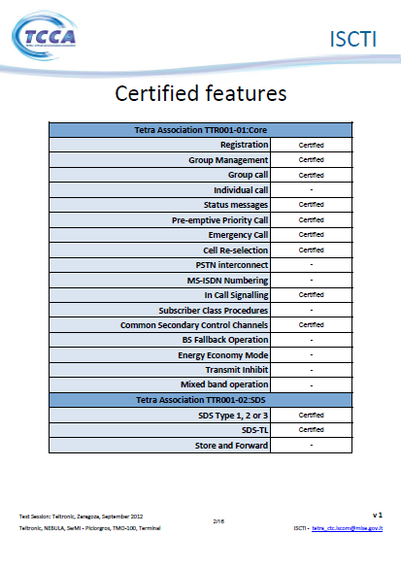
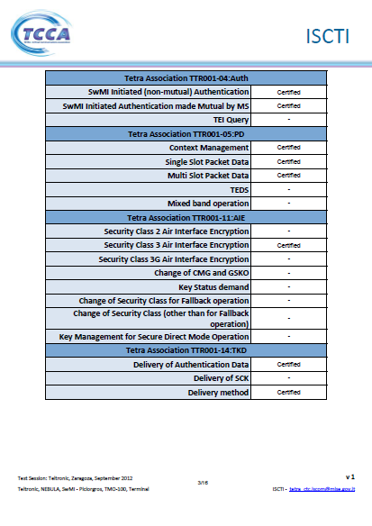

Slide 10
TMO-100 = Tetra MOdem -100
Second Generation
Professional TETRA
Data Modem with Voice Option

Slide 11
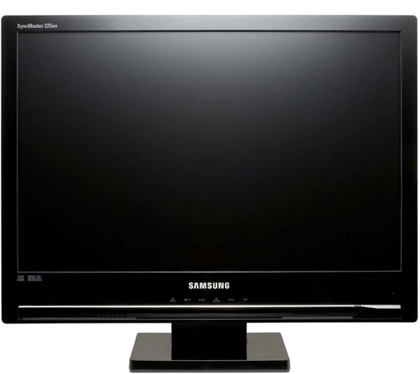
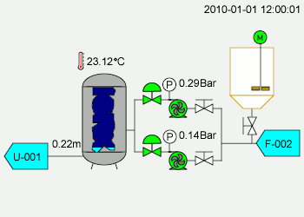
Typical SCADA Server Layout
Ref:
Scada: Wikipedia
Monitor: Samsung

Slide 12
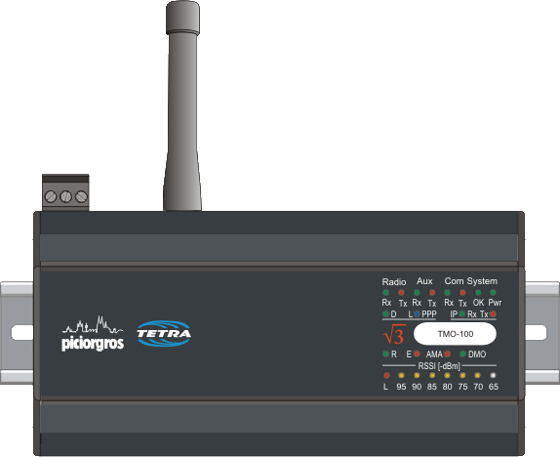
TETRA Modem - TMO-100
with two serial Ports, one Ethernet Port and an optional Audio Port

Slide 13
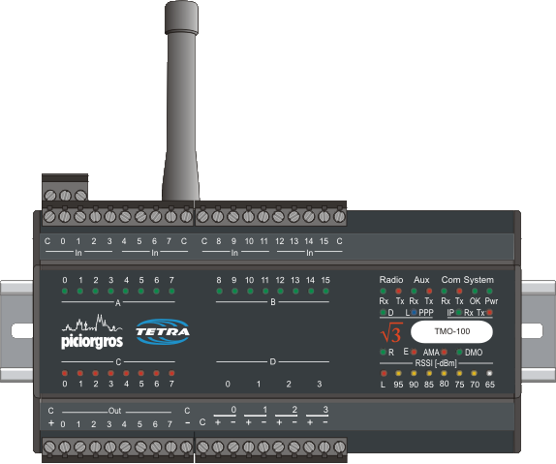
TETRA Modem - TMO-100 as before with additional embedded I/O

Slide 14
Power Supply:
12 Volt up to 24 Volt +/-20%

Slide 15
Heavy Duty Connectors

Slide 16
DIN-Rail Mounting

Slide 17
SMA Antenna Connector

Slide 18
16 digital Inputs including …
8 Event Counter and 8 Timer (*)
All inputs visible as LED

Slide 19
8 (16) digital Outputs
PNP open Collector (500 mA each)
All Outputs visible as LED

Slide 20
4 analog Inputs
0-20 mA or 4-20 mA

Slide 21
8 LED Field Strength
Bar Graph indicating –dBm values

Slide 22
Antenna Match LED (AMA)
Indicates no, or faulty connected Antenna

Slide 23
Two Serial Ports on top (D-Sub)
RS-232 or RS-485 / (RS-422)

Slide 24
10/100 MB Ethernet Port

Slide 25
Connector for Microphone/Speaker
(Hardware Option)

Slide 26
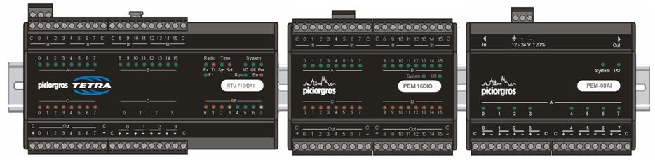
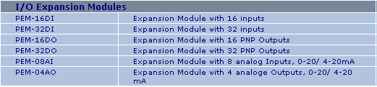
Large Variaty of Expansion Modules
(Hardware Option)
Notes:
26

Slide 27
TETRA Data Network Structure
Radio-to-Radio

Slide 28
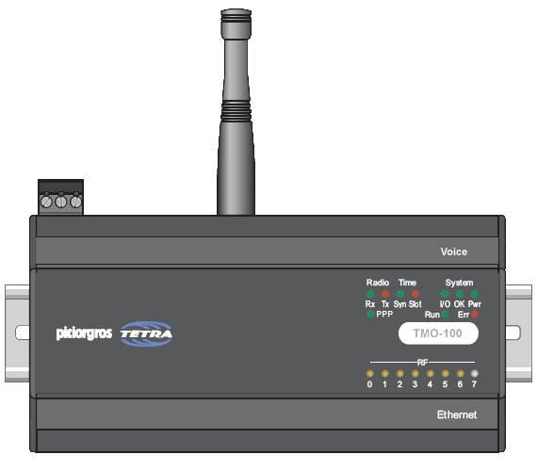


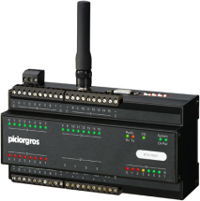
SCADA using based Radio-to-Radio Communication
SDS
SCADA Control Room
Serial Interface
Public Lighting
SDS
TMO-100
Serial Communication
SDS
SDS
TMO-100
I/O
TMO-100
Command and Control Device
SDS
Serial Interface
PLC / RTU
Tetra Switch
TMO-100
Notes:
28

Slide 29
TMO-100
TETRA Data Modem
Network Structure
Data Gateway-to-Radio

Slide 30
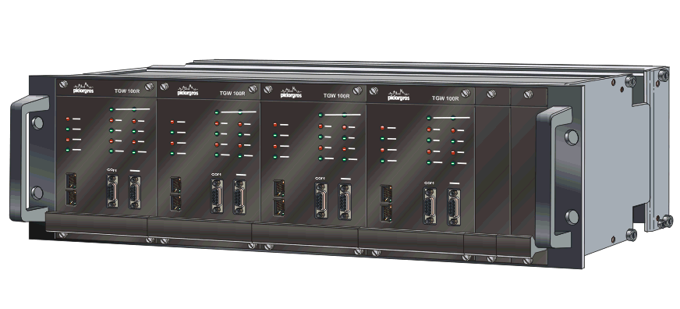
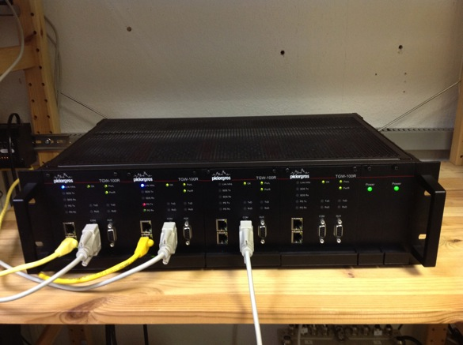
Highly Redundant TETRA Packet Data Gateway for SCADA Critical Operation

Slide 31
Highly Redundant TETRA Packet Data Gateway for SCADA Critical Operation
Supported Protocols:
MODBUS-RTU
IEC60870-5-101
DNP3
ROC
BSAP
PakBus
Siemens SINAUT
any customer specific or proprietary protocols

Slide 32
Highly Redundant TETRA Packet Data Gateway for SCADA Critical Operation
Features:
COM Ports:
RS-232 or RS-485/422, Subin-D pole female
AUX Ports:
RS-232 or RS-485, RJ12 pole female
Ethernet Ports:
One (TGW-100) or two (TGW-100R)
Ethernet interfaces:
RJ-45, 10/100 MBps
Power Supply
Dual Power Supplies – hot swappable
Enclosure dimensions:
Complete 19" rack approx: 48,4 * 13,2 * 33 cm (no cables included)

Slide 33
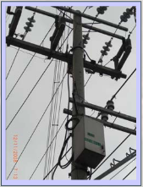

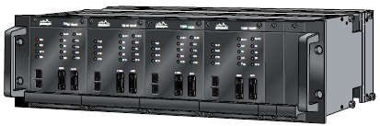
SCADA – using an
SDS Gateway
Control Room
Public Lighting
SDS
TMO-100
Two Serial Interfaces
TGW-100
SDS Gateway
SDS
TMO-100
I/O
Command and Control Line Device
IP Communication
SDS
AMR
TETRA Switch
TMO-100

Slide 34
Performance Test with SDS-Gateway on ONE SCCH/MCCH:
Infrastructure: TETRA with one carrier
TETRA Data Link: One SCCH
Data Compression: OFF
Data nodes: One or more polling nodes, polling 10 TMO-100 each
Protocol: Modbus RTU
Polling Target: Polling different numbers of bytes from inside the TMO-100
 | One Node | Two Nodes | Three Nodes | Four Nodes | Eight Nodes
SDS: 20 Bytes | 65 | 130 | 240 | 250 | 295
SDS: 100 Bytes |  |  |  |  | 285
SDS: 200 Bytes |  |  |  |  | 265
Table showing polls per minute
Notes:
34

Slide 35
Performance Test with SDS-Gateway on FOUR SCCH/MCCH:
Infrastructure: TETRA with one carrier
TETRA Data Link: MCCH plus three SCCH
Data Compression: OFF
Data nodes: One or more polling nodes, polling 10 TMO-100 each
Protocol: Modbus RTU
Polling Target: Polling different numbers of bytes from inside the TMO-100
 | One Node (on each TS) | Two Nodes (on each TS) | Three Nodes (on each TS) | Four Nodes (on each TS) | 16 Nodes (on each TS)
SDS: 20 Bytes | 210 | 400 | 600 | 760 | 980
SDS: 100 Bytes
SDS: 200 Bytes
Table showing total polls (on all time slots) per minute (values rounded)
Notes:
35

Slide 36

SCADA – using a Gateway
Packet Data
SCADA Control Room
TMO-100
I/O
… or Serial Interface
PD
Two Serial Interfaces
TGW-100
SDS Gateway
PD
TMO-100
Analog and Digital I/O
Command and Control Line Device
IP Communication
PD
Serial Interface
PLC / RTU
Tetra Switch
TMO-100

Slide 37
SCADA – using direct Communication
IP
SCADA Control Room
IP
PD
TMO-100
PD
Direct IP Communication
TMO-100
I/O
Command and Control Line Device
PD
IP
AMR, PLC or RTU
Tetra Switch
TMO-100

Slide 38
SCADA – using a Gateway
Packet Data
SCADA Control Room
TMO-100
I/O
… or Serial Interface
PD
PD
PLC / PRTU
PLC / PRTU
PLC / PRTU
PLC / PRTU
TMO-100
Analog and Digital I/O
Command and Control Line Device
PD
Serial Interface
TGW-100
SDS Gateway
PLC / RTU
IP Commu-nication
TMO-100
TETRA Switch

Slide 39
TMO-100
TETRA Data Modem
Feature List

Slide 40
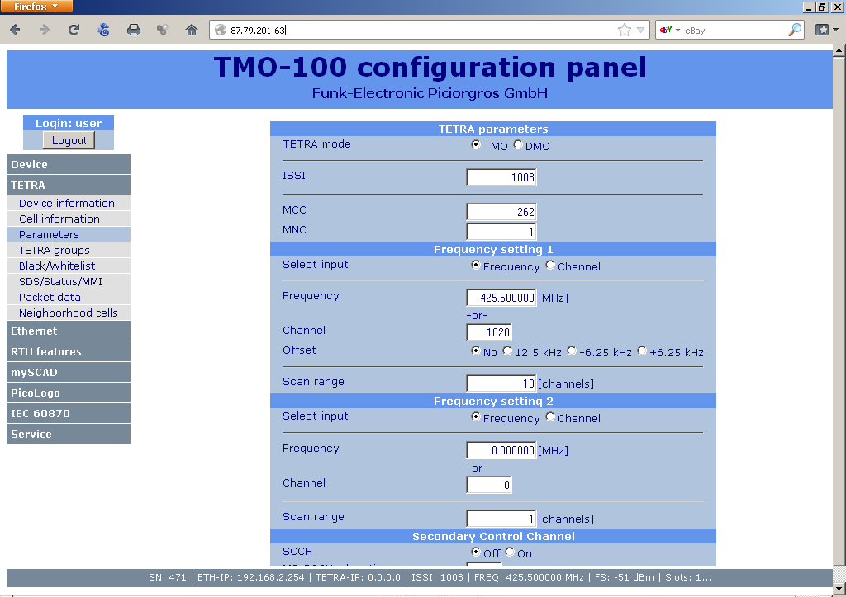
Embedded Web-Browser

Slide 41
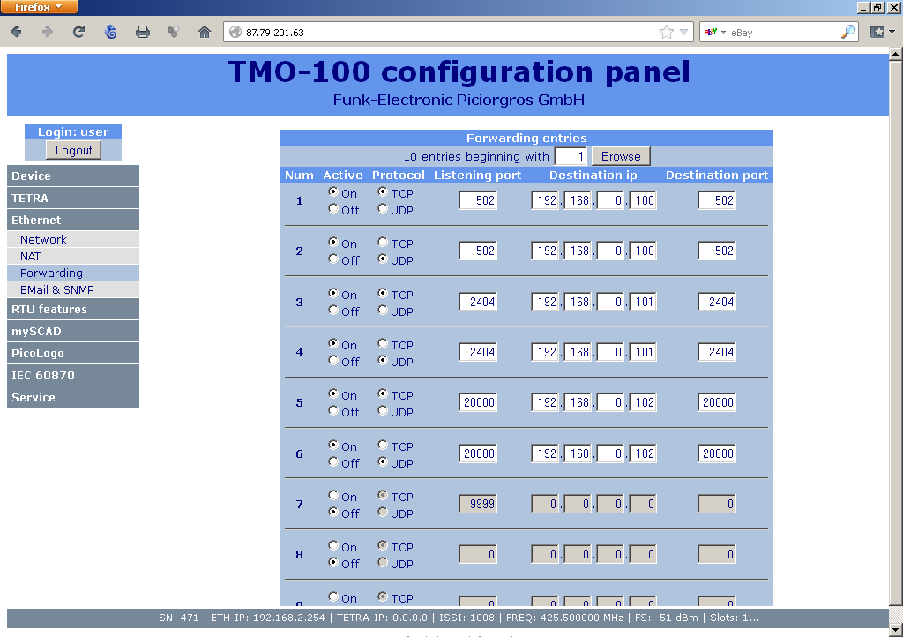
Embedded IP and TETRA Router

Slide 42
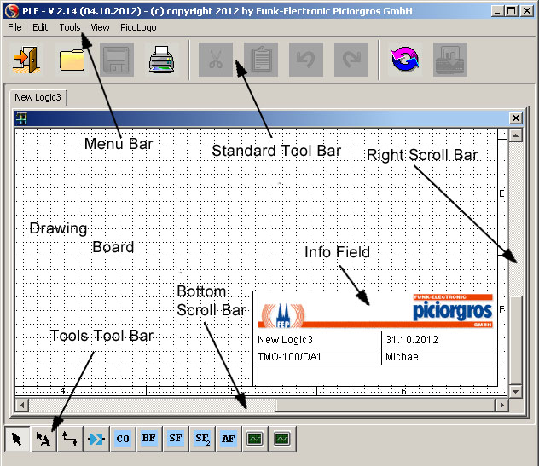
PLE - Powerful Java Graphic Editor

Slide 43
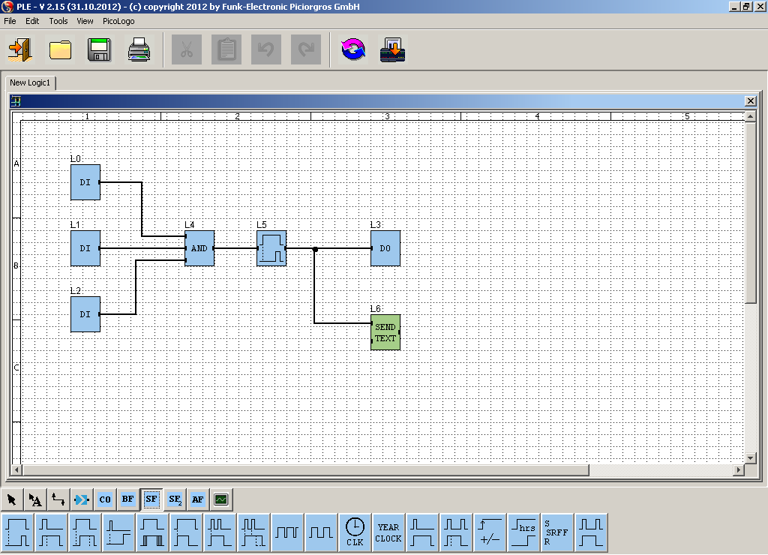
No Cryptic Formulas for Logic design

Slide 44
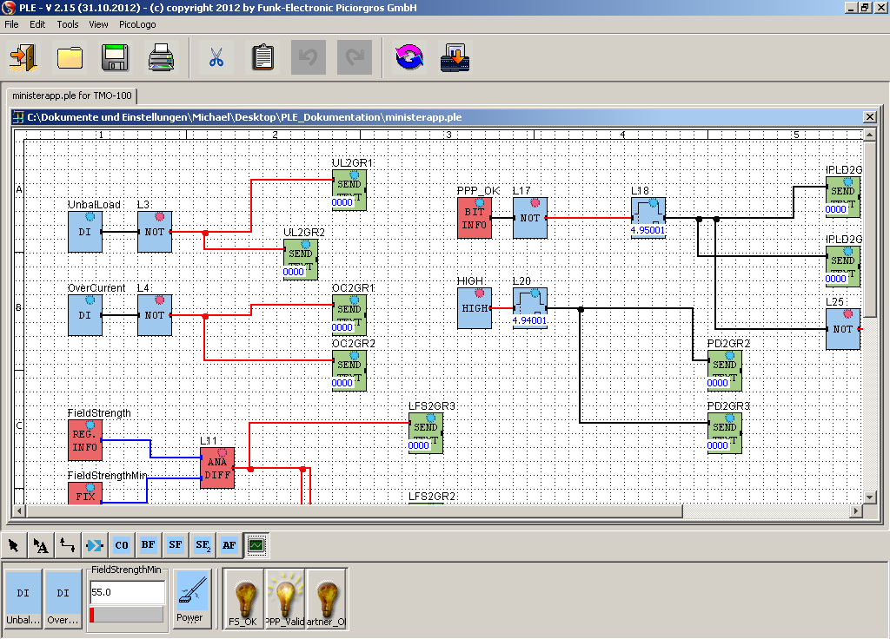
Powerful embedded Micro PLC

Slide 45
TMO-100
TETRA Data Modem
Features

Slide 46
TMO-100 - TETRA related Features
SDS can be up to 255 bytes (2047 Bit) long. Type TL and TL 4
Packet Switched Data (IP) supported
Packet Data Channel Sharing supported
Single and Multi Slot Packet Data supported
Secondary Control Channel supported
Automatic PPP Link set up to the TETRA Switch
Router Function with Port Forwarding and NAT
Up to 3 Watt RF Output Power
Encryption, Authentication
Voice feature even with active Packet Data Link
Build in Tetra Monitor (local and remote) via embedded Web Server
Calibrated Field Strength Indicator on the Front Panel
Short Data or SDS can be sent as alarms (low field strength ...)
350 MHz, 380 MHz, 410 MHz 450 MHz and 800 MHz available

Slide 47
TMO-100 – Voice Option
Standard 8 Pin Connector for Mic. Speaker handset
One Group Number (GISSI) to be programmed
Eight individual Numbers (ISSI) to be programmed
ISSI and GISSI to be programmed locally or remotely using the embedded Web Server
Select ISSI / GISSI by Voice Handset
Automatic PPP disconnect when pressing PTT
Automatic PPP re connect after Voice timeout or reject

Slide 48
TMO-100 – Protocol and I/O related Features
All digital and analog I/O isolated
Serial Port COM / AUX available as RS-232 or RS-485/(422)
Level 1 Protocol: Timeout or 3964R
Serial Protocols can be sent via SDS or Packet Data (SoIP)
IP Protocols can be sent via Packet Data or SDS (IPoSDS)
Device Protocol to access internal Registers: Modbus RTU, Modbus IP, IEC60870-5-101, IEC60870-5-104
Serial Protocols to be forwarded:
Modbus RTU, DNP3, IEC 60870-5-101, PakBus, BSAP, ROC, … user Defined …
Ethernet 10/100 MBit IP-Port for Local Network
UDP and TCP supported
Embedded Web Server as Configuration Tool
Modbus/IP, IEC 60870-5-104 (!), DNP3/IP, … others …
Low Power Consumption: <3 Watt

Slide 49
PicoLogo™ – User Application Interface
Easy to use graphical user interface
Optimized for Tetra Infrastructure
Basic Logic Functions (and, or, exor, … )
Complex Logic Functions (delay on, delay off, flip flop, …)
Analog Functions (analog compare, … )
Timer and Clock Functions (time, date,
Dynamic Text Message generation for Alarms and Status
GPS Functions (position, … )
Modbus RTU Slave (set and read register, coil, … )
Modbus RTU Master (set and read register, coil, … )
E-Mail send (sending text and alarm messages by e-mail)
SNMP Trap (automated machine messaging)
… more …

Slide 50
TMO-100 – Embedded Web Server
Web Server to be used as …
Configuration Tool for the Device, Protocols and IP Parameter,
Configuration Tool for TETRA Network Parameter,
Configuration for the Voice Option
TETRA Monitor
Device Monitor
Error Log
Web Server can be accessed locally using the IP Port and remotely over the TETRA Infrastructure
Easy to be used with any Web Browser (Firefox, Internet Explorer, … )

Slide 51
TMO-100
TETRA Data Modem
Unique Features

Slide 52
TMO-100
Feature rich All in One SCADA and Telemetry Solution
TETRA-Modem and TETRA-RTU
Interfaces fit the User Requirements and User Protocols (no ATDT .... Commands)
Embedded WEB Server
Embedded IP Router
Optional build in Digital and Analog I/O
Optional Voice Feature
Field proven in many applications
IOP approved for most of the existing infrastructures
IC and FCC approval
3 Watt RF power output in 350 – 470 MHz range
DIN Rail Mounting and 12-24 Volt DC +/-20% power supply
New: Over The Air Upgrade of Modem and TETRA Stack

Slide 53
Typical SCADA Applications:
Notes:
53

Slide 54

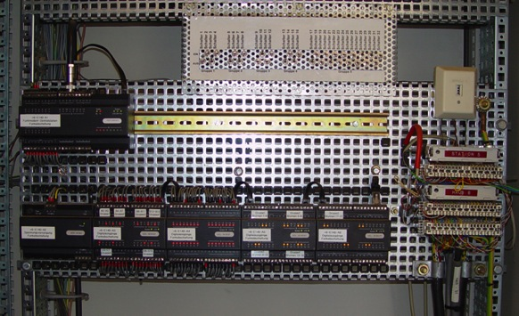
Open Pit Mining (Water Level Control)

Slide 55
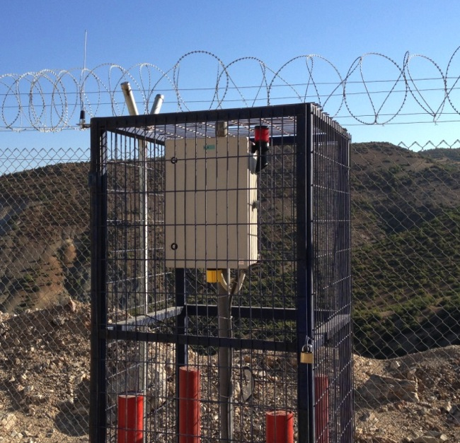
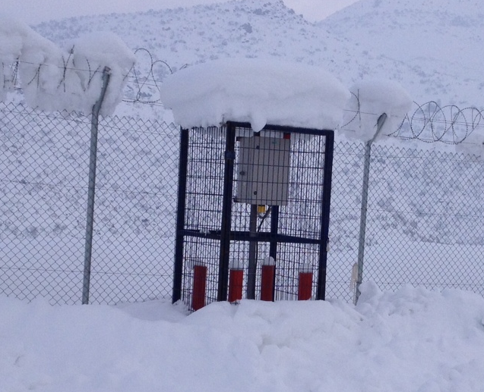
Turkey, Mining Application – DMO Mode

Slide 56
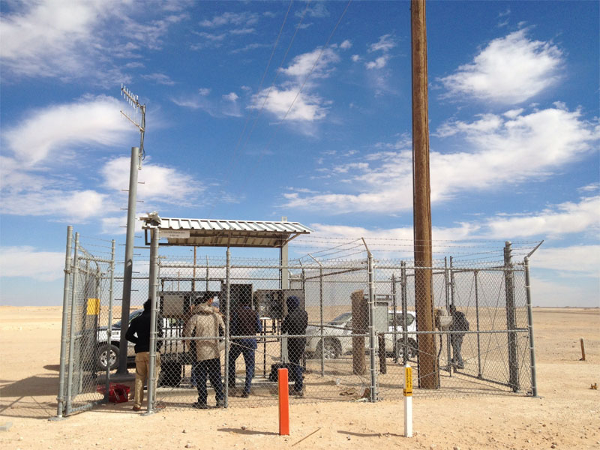
ME, Gas and Oil

Slide 57
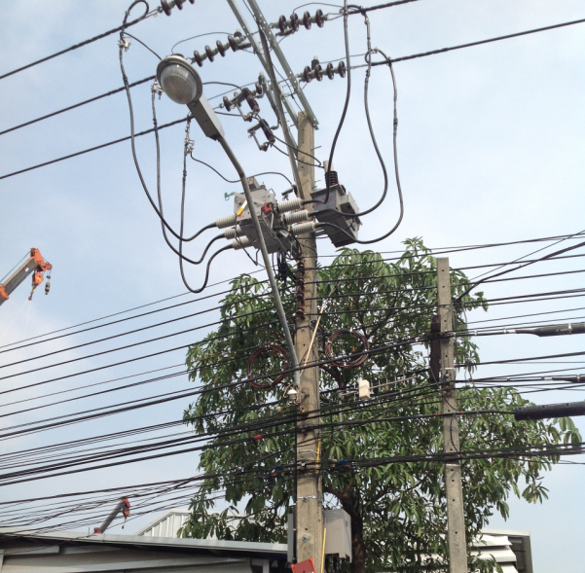
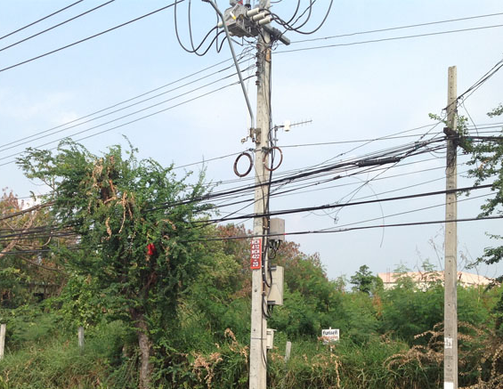
Asia, Utility (Energy Companies) Pole Mounted Switches
Notes:
57

Slide 58


Slide 59
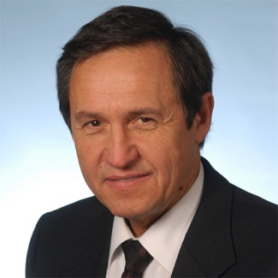

Thank you very much for your interest in our Products
Funk - Electronic Piciorgros GmbH
Claudiastr. 5
51145 Köln-Porz
Germany
www.piciorgros.com
www.TetraModem.com

