Slide 1

TETRA technology –
A suitable solution for telemetry, SCADA and data applications
Funk-Electronic Piciorgros GmbH Stephanie D. Piciorgros

Slide 2
Content
Level 1 – TETRA features in general
1.a – General information on TETRA
1.b – TETRA features
1.c – Security features
Level 2 – TMO-100 specific features
Level 3 – SCADA specific features

Slide 3
Level 1 – General Information on TETRA
TErrestrial Trunk RAdio
Trunking system comparable with cellular (GSM) networks
Narrow band
Bandwith of 25 kHz with four time slots (which would equal 6.25 kHz per time slot)
MCCH
Main Control Channel
Traffic Channels

Slide 4

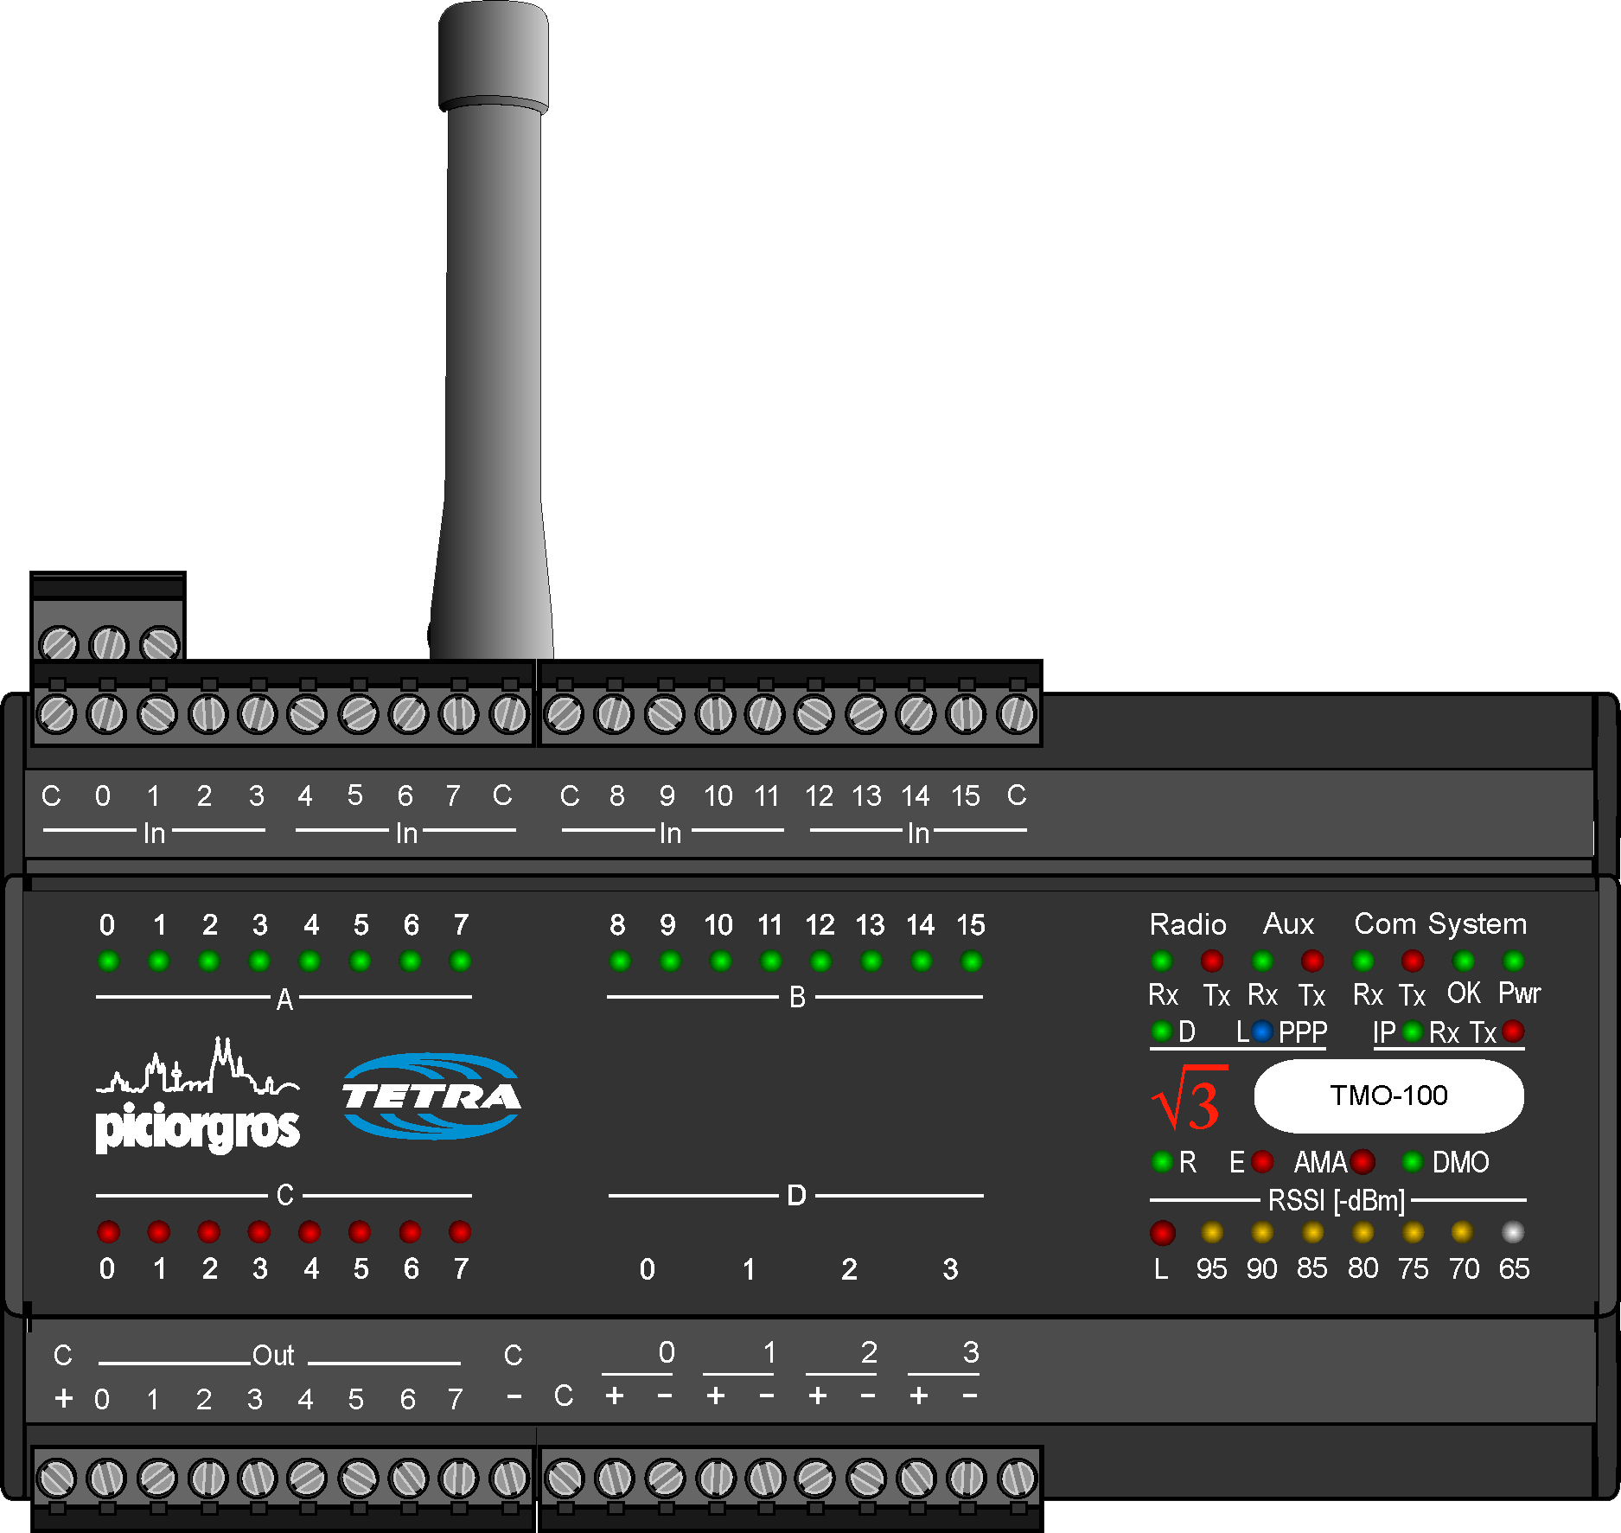
Level 1 – General Information on TETRA
DMO (Direct Mode)
TMO (Trunked Mode)

Slide 5
Level 1 – TETRA Features
Status Message
SDS
SSCH
PD
MSPD

Slide 6
Level 1 – TETRA Features Status Message
A Status message is the shortest and fastest way to send or receive command or status information over TETRA
Status Message size is 16 Bit
Can be sent/received from control room (SCADA) or from any outstation
STATUS messages can be used for:
Alarm Information from outstations
Polling Request
Commands to send to Outstations

Slide 7
Level 1 – TETRA Features SDS (Short Data Service)
An SDS message can be compared with an SMS text message in GSM networks but an SDS will be delivered instantly
SDS single message size is up to 254 byte
Multi SDS can be used for larger data
SDS messages can be used for:
Text communication
Data communication (protocols, alarms, . . . )

Slide 8
Level 1 – TETRA Features SCCH (Secondary Control CHannel)
SDS Messages are sent on the MCCH (Main Control CHannel) on the first time slot
Additional control channels (SCCH) can be configured for each of the remaining three time slots
On one carrier a maximum of four control channels is possible
SCCH messages can be used for:
Separate data from MCCH or Voice Traffic
Reduce MCCH load
Split applications

Slide 9
Level 1 – TETRA Features SCCH (Secondary Control CHannel)
MCCH
TCH
TCH
TCH
MCCH
SSCH
TCH
TCH
MCCH
SSCH
SSCH
SSCH
MCCH
TCH
TCH
TCH
SCCH
TCH
TCH
TCH

Slide 10
Level 1 – TETRA Features PD (Packet Data)
With Packet Data, IP communication is possible on TETRA networks
Packed Data uses Traffic Channels for communication, in the same way as voice communication
TETRA provides Packet Data channel sharing between devices
PD can be used for:
UDP communication
TCP communication
Any low speed IP application (SCADA Data)

Slide 11
Level 1 – TETRA Features PD (Packet Data)
MCCH
TCH
TCH
PDCH
A dedicated data channel is recommended
when transmitting data over TETRA when
the data is mission critical and numerous devices are being used in the field.

Slide 12
Level 1 – TETRA Features PDCS (Packet Data Channel Sharing)
Most of the SCADA applications use polling protocols. That means that the SCADA Server (Control Room) sends a request to an outstation asking for process data. And once the outstation device has responded, the next field device will be polled. In case of Packet Data communication, with each polling the specific outstation will switch to the packet data traffic channel and respond to the SCADA Server request. As there is no logical “End of Packet Data” for the TETRA infrastructure, each device will stay after the data communication has been terminated for some additional time until a “Ready Timer” expires. During that time the TETRA Channel (Time Slot) is blocked for other devices. With the Packet Data Channel Sharing, additional devices can use these still “occupied” data channels and already start communication what results in much higher data communication speed

Slide 13
Level 1 – TETRA Features MSPD (Multi Slot Packet Data)
Multi Slot Packet Data uses two up to three traffic channels on the first carrier
Multi Slot Packet Data can use up to four traffic channels on the second carrier
MSPD can be used for:
UDP communication
TCP communication
Any low speed IP application (SCADA Data)

Slide 14
Level 1 – Security Features Authentication
Only valid subscribers can access the TETRA system
Provides proof identity of all radios attempting use of the network
Radio can authenticate the network too, protects against ‘fake base stations’ etc
Authentication can be used for:
Secure communication
Authentication of user by infrastructure
Authentication of infrastructure by user

Slide 15
Level 1 – Security Features AIE (Air Interface Encryption)
AIE prevents anyone from listening to air channels during communication
Three classes of Security
Class 1 – no encryption (but can include Authentication)
Class 2 – Static Cipher Key Encryption (but can include Authentication)
Class 3 – Dynamic Cipher Key Encryption (Authentication required)
Four standard air interface encryption algorithms
TEA 1 & 4 – Used outside of Europe for non-public safety
TEA 2 – Used inside of Europe for public safetly and military
TEA 3 – Used for public safety and military where TEA2 is not allowed
AIE protects control channel messages and identities as well as voice and data payloads

Slide 16
Level 1 – Security Features E2EE (End-to-end-Encryption)
Highest level of encryption
Sender encrypts information and only the receiver can decrypt it
Fully encrypted between the terminals (or data modems) end to end
Protects:
Voice services
Data (SDS) services
Packet Data services

Slide 17
Level 1 – Security Features Temporary and Permanent Disable
In case a terminal/modem is stolen, it can be temporarily disabled to prevent misuse of devices
In case the device will be found again, the device can be enabled again
In case a terminal/modem will not be found again, the device can be premanently disabled (killed)
In this case the device is „dead“ and cannot be used anymore

Slide 18
Level 2 – TMO-100 specific features
The features explained in the following slides are all related to the TMO-100
These features are optional and can be purchased at time of TMO purchase or afterwards

Slide 19
Level 2 – TMO-100 specific features Web Server
All parameters are configured via embedded web server
Changes can be made to TMO‘s TETRA parameter like frequency range, ISSI, MNC, MCC and more
TMO-specific changes can be made to e.g. groups, priority/black/white lists, PD parameter, voice options
Additional post-TMO-puchased keys can be uploaded into device
All puchased features/options are listed in the Web Server
TMO behavior can be observed in the event logger

Slide 20
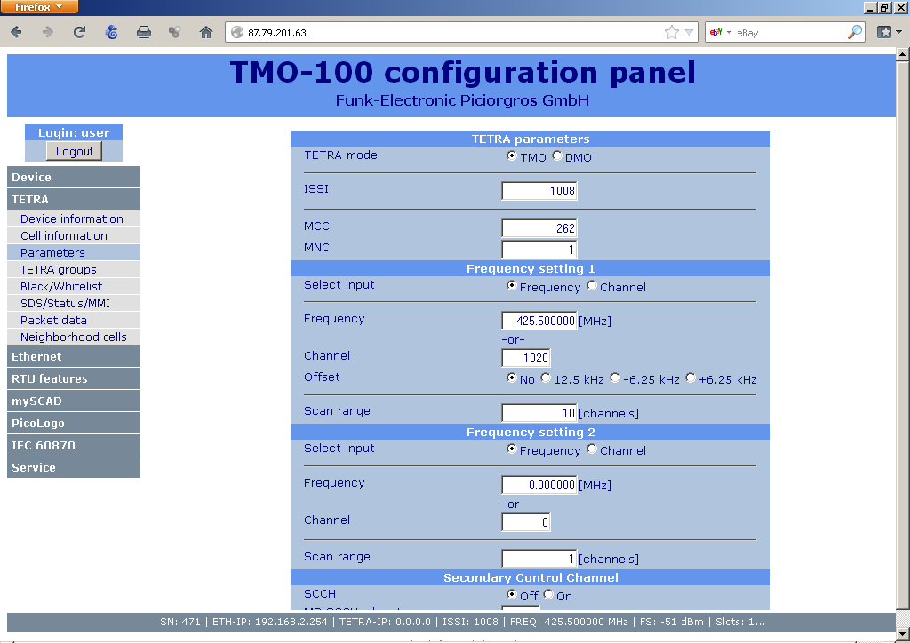
Level 2 – TMO-100 specific features Web Server

Slide 21
Level 2 – TMO-100 specific features OTA (over the air updates)
Modems should be updated over the air
Stack, MMI, DSP and Modem Firmware will be updated
OTA updates are send via SDS to dedicated OTA groups (preconfigured)
Several thousand devices can be updated simultaneously
Timer can be set to ensure the updates are being distributed at a slower time of the day (night time?)
security approval after distribution of update
If update was unsuccessful, TMO will automatically retrieve the last versions from before OTA was started

Slide 22
Level 2 – TMO-100 specific features Priority List, Grey List, Black List
Priority List
Modem should re-
gister to the BS in
order of Priority List
if the RSSI is at a
certain preset mini-
mum level
Grey List
Modem will not re-
gister to any BS on
this list IF there are
any other cells that
it can connect to.
If not, it will re-
gister to cells in
the Grey List
Black List
Modem will never
register to any BS
on this list no matter
what happens.

Slide 23
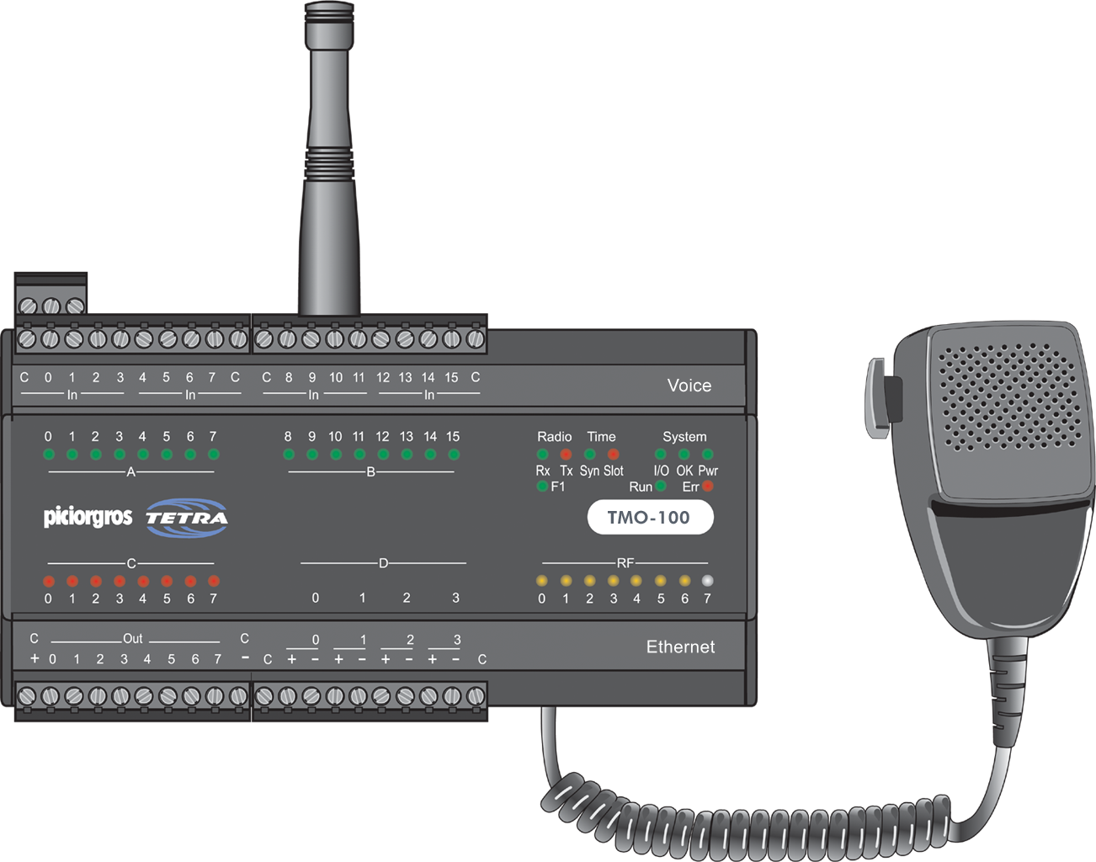
Level 2 – TMO-100 specific features Voice Features
Voice Speaker Mic Feature
Voice Alarm Feature
Hardware Option
For emergency situations
Pre-set ISSI or GSSI (e.g.control room)
Software Option
Record up to 16 Voice messages that can be sent out in emergency situation
Up to 15 seconds in length
Individual or Group Call
Can be connected to loudspeaker for emergency situations

Slide 24
Level 3 – SCADA specific features
Data transmission over TETRA
Different Protocols supported by the TMO-100
Serial and IP Protocols
Serial over IP transmission
Routing Table
RTU with embedded I/O
PicoLogo

Slide 25
Level 3 – SCADA specific features Data transmission over TETRA
AT Modem
AT commands are
supported by
TETRA radios. For
SCADA applications
an external con-
troller is needed to
convert the SDS
data into industry
protocols.
Data Modem
Can be connected
directly to any SCADA device (e.g.
PLC/RTU) and
supports serial as
well as IP-based
protocols.
TETRA RTU
In addition to the
data modem
features the TETRA
RTU has embedded
digital and analog
I/Os, which can be
accessed by
standard SCADA
protocols.

Slide 26
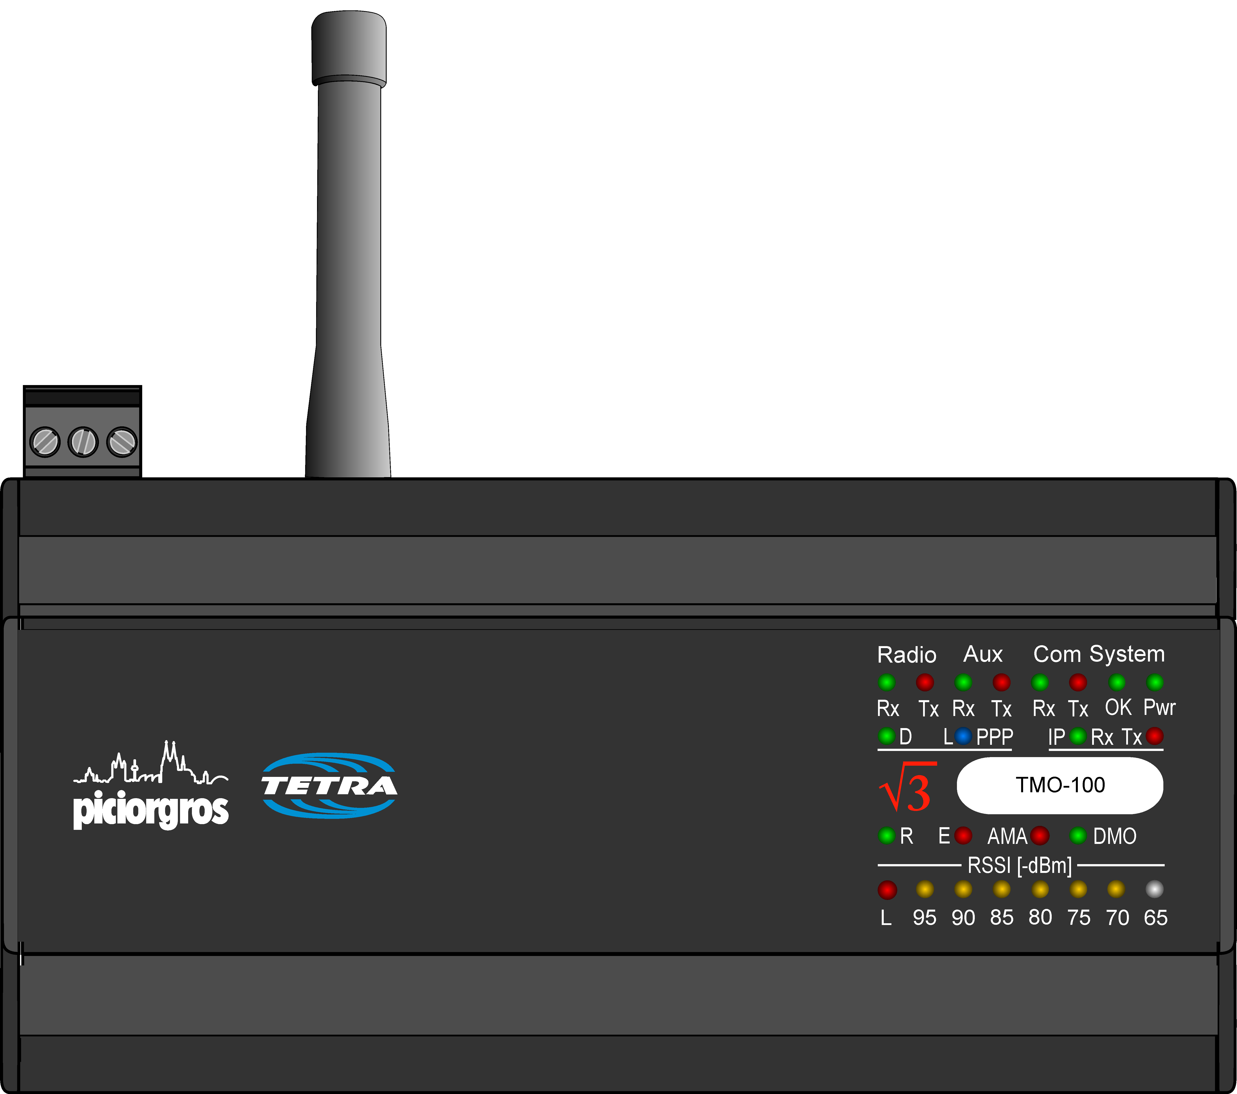
Level 3 – SCADA specific features Different Protocols supported by the TMO-100
Modbus serial & IP
IEC-60870-5-101
IEC-60870-5-104
PakBus
Many More
ROC Protocol
DNP3 serial & IP
User specific protocol
BSAP

Slide 27
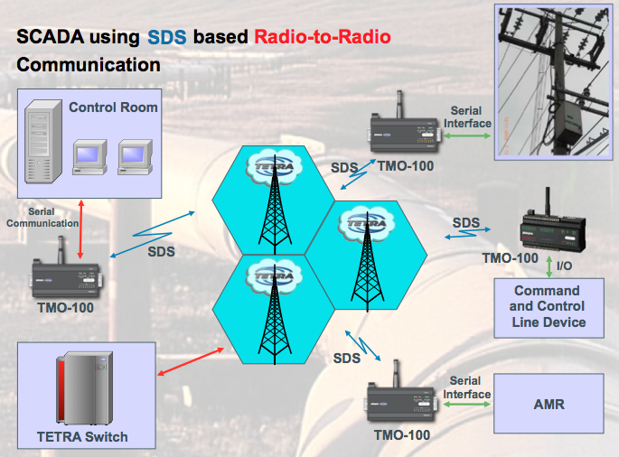
Level 3 – SCADA specific features Serial Protocols
Serial Protocols
RS-232 (RS-485/422)
SDS Communication

Slide 28
Level 3 – SCADA specific features TGW-100 TETRA Gateway
Radio-to-Radio
Faster Set-up
Involves less cost
Single data transfer
results in 2 transmission
Uplink and Downlink
Highest latency
Slowest speed
No connection to Infra-
structure is needed
Bottleneck on Master
Side
Used for pilots or small
projects
Using TGW-100
Recommended Scenario
Lower latency (half)
Higher Speed (double)
Connection to Infra-
structure is needed
No bottleneck on master
side
Protocol analysis and
routing, data compression...
Used for projects of any
size

Slide 29
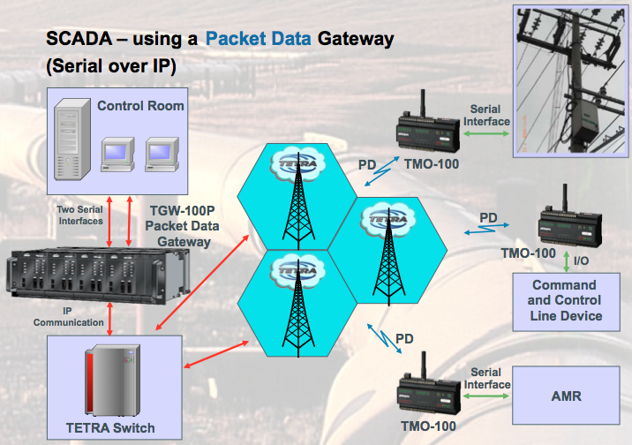
Level 3 – SCADA specific features Serial over IP
For serial protocols that will be sent via Traffic Channel (PD) rather than via the MCCH/SCCH (SDS) in order to avoid unwanted traffic on MCCH/SCCH

Slide 30
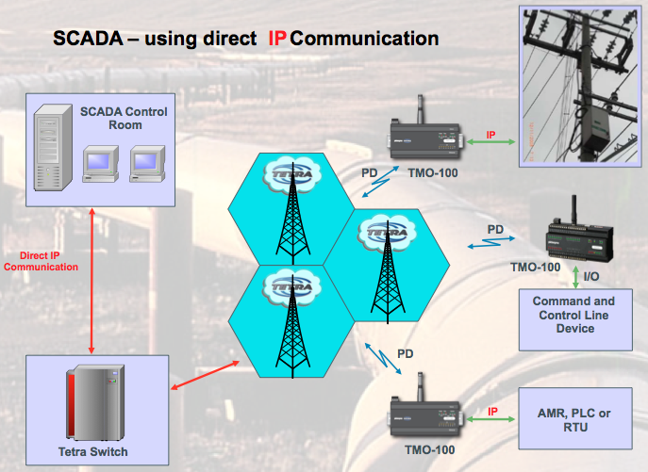
Level 3 – SCADA specific features IP Protocols/ Pure IP Connection
IP Protocols
Ethernet Port
PD or MSPD

Slide 31
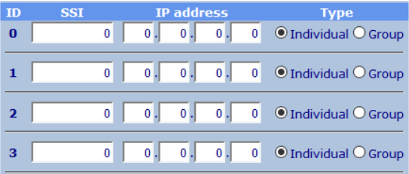
Level 3 – SCADA specific features Routing Table
Can hold up to 1024 entries
User can configure the destination address for either SDS transmission (using an SSI) or packet data transmission (using a dedicated IP address)

Slide 32
Level 3 – SCADA specific features RTU with embedded I/Os
Call Out Alarms
Expansion Modules
Voice Alarms
Digital I/Os
Analog I/Os
Control via Status
PLC Function
SCADA protocols
Counter / Timer

Slide 33
Level 3 – SCADA specific features PicoLogo - MircoPLC
PicoLogo Editor is an application platform that enables the user to write their own logics in a simple, user-friendly way
Combine embedded I/Os with logic funtions
Set up M2M communication
Supervision of TETRA BS
Send text- and alarm messages to other TMOs or terminals
Send (pre-set and pre-recorded) voice alarms
Trigger outputs and functions by status messages
Much more
PicoLogo feature in an optional feature in TMO-100
Example: Send an SDS triggered by an event (sensor triggered) only at a specific time (door open outside opening hours)

Slide 34
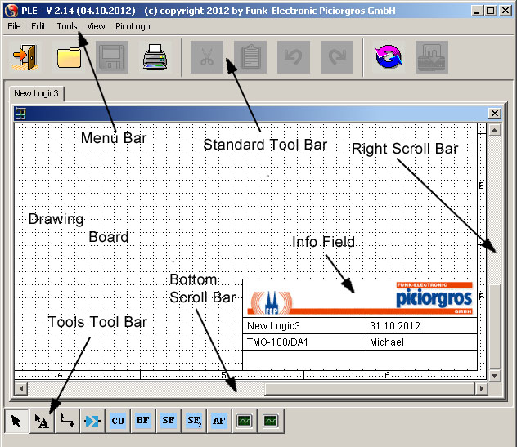
Level 3 – SCADA specific features PicoLogo Editor

Slide 35
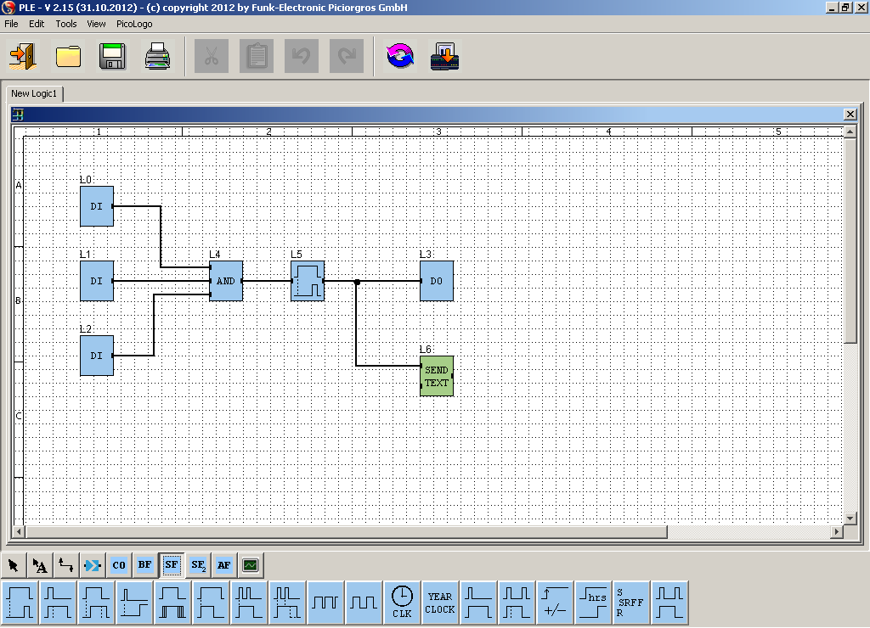
Level 3 – SCADA specific features PicoLogo Editor

Slide 36
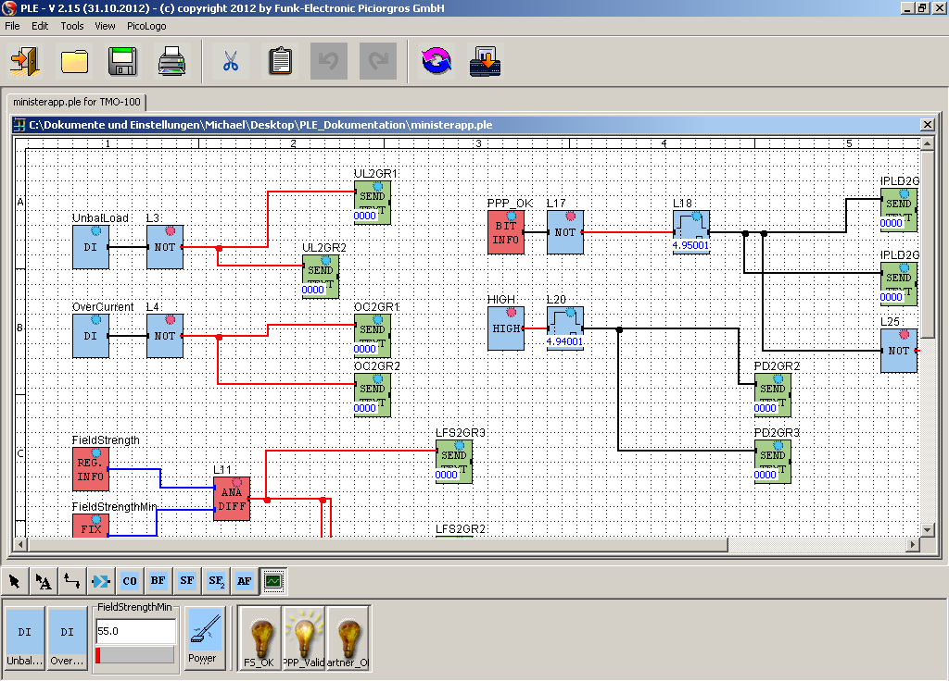
Level 3 – SCADA specific features PicoLogo Editor

Slide 37
TMO-100 – a powerful TETRA device for your SCADA applications

Slide 38

Thank you very much for your interest in our Products
Funk - Electronic Piciorgros GmbH
Claudiastr. 5
51145 Köln-Porz
Germany
www.TetraModem.com
Notes:
38

Slide 39




Download Product
PPT here
Download this
PPT here
Download Technical
Documentation here
Notes:
39

